Slide 1
MEMORY MANAGEMENT STRATEGIES IN COMPILER DESIGN
BY: CH. SRAVANI-192211962
V. RANJITHA-192211963
M. SWETHA- 192211983

Slide 2
Contents of this project
Abstract
Introduction
Literature review
Research plan
Methodology
Result and Conclusion

Slide 3
01
ABSTRACT

Slide 4
ABSTRACT
Memory management strategies in compiler design are crucial for optimizing system performance and resource allocation, and involve various techniques and software.
Storage allocation strategies include static allocation, heap allocation and stack allocation.
Static allocation, which assigns storage for all data objects at compile time.
Heap allocation, which dynamically allocates and deallocates memory at runtime.
Stack allocation, which allocates memory at runtime using a stack data structure.

Slide 5
Additionally, memory management techniques like paging, which divides memory into fixed-size blocks called pages.
Swapping, which exchanges processes between RAM and secondary memory.
Compaction, which reduces fragmentation by combining free memory spaces.
And segmentation, which divides programs into segments of different sizes, are also employed.
Various software, including compilers like C, C++, Python, and Java, and operating systems like Windows, Linux, and Mac OS X, support these memory management strategies.

Slide 6
02
INTRODUCTION

Slide 7
INTRODUCTION
Memory management is a crucial aspect of compiler design responsible for allocating and deallocating memory efficiently during program execution.
Different strategies achieve this based on the data's lifetime, access patterns, and size. Memory management significantly impacts a program's performance, correctness, and resource utilization.
Efficient allocation minimizes fragmentation, prevents memory leaks, and optimizes memory access times. Efficient memory management directly impacts a program's performance.

Slide 8
Memory management strategies in compiler design refer to the techniques and algorithms used to manage and optimize the use of memory during the compilation and execution of programs.
Effective memory management is crucial in compiler design as it directly impacts the performance, efficiency, and reliability of the system.
By employing various storage allocation strategies, runtime environments, and memory management techniques, compilers can optimize memory usage, improve program execution speed, and enhance
overall system performance.

Slide 9
03
LITERATURE REVIEW

Slide 10
LITERATURE REVIEW
Memory management strategies in compiler design have been extensively researched. Studies have explored various storage allocation strategies, including static, heap, and stack allocation.
Researchers have also investigated runtime environments, such as activation trees and control stacks.
These studies aim to optimize memory usage and improve program execution speed
Researchers also aim to develop more efficient
garbage collection algorithms and improve memory
safety in compilers.

Slide 11
05
METHODOLOGY

Slide 12
METHODOLOGY
I. Problem Definition:
Identify memory-related issues (e.g., memory leaks, fragmentation, overhead) in existing compiler designs.
II. Memory Management Strategy Selection
1. Investigate existing memory management techniques (e.g., static, stack, heap, garbage collection).
2. Analyze trade-offs between memory usage, execution time, and implementation complexity.
3. Select suitable memory management strategies for the target compiler and programming language.

Slide 13
III. Design and Implementation
1. Design a memory management framework integrating the
selected strategies.
2. Implement memory allocation, deallocation, and management functions.
3. Integrate memory management with compiler components (e.g., parser, optimizer, code generator).
IV. Optimization and Fine-Tuning
1. Profile and analyze memory usage patterns in target programs.
2. Apply optimization techniques (e.g., caching, prefetching, memory pooling). 3. Fine-tune memory management parameters (e.g., allocation sizes, garbage collection frequencies).

Slide 14
V. Testing and Validation
1. Develop a comprehensive test suite for memory management functionality. 2. Evaluate performance, memory usage, and correctness using benchmarks
and stress tests.
VI. Runtime Environment Integration
1. Integrate the memory management system with the runtime environment (e.g., operating system, libraries).
2. Ensure compatibility with various hardware architectures and memory configurations.
VII. Maintenance and Evolution
1. Monitor memory management performance and adapt to changing program behavior.
2. Refine and extend memory management strategies as needed

Slide 15
06
RESULT

Slide 16
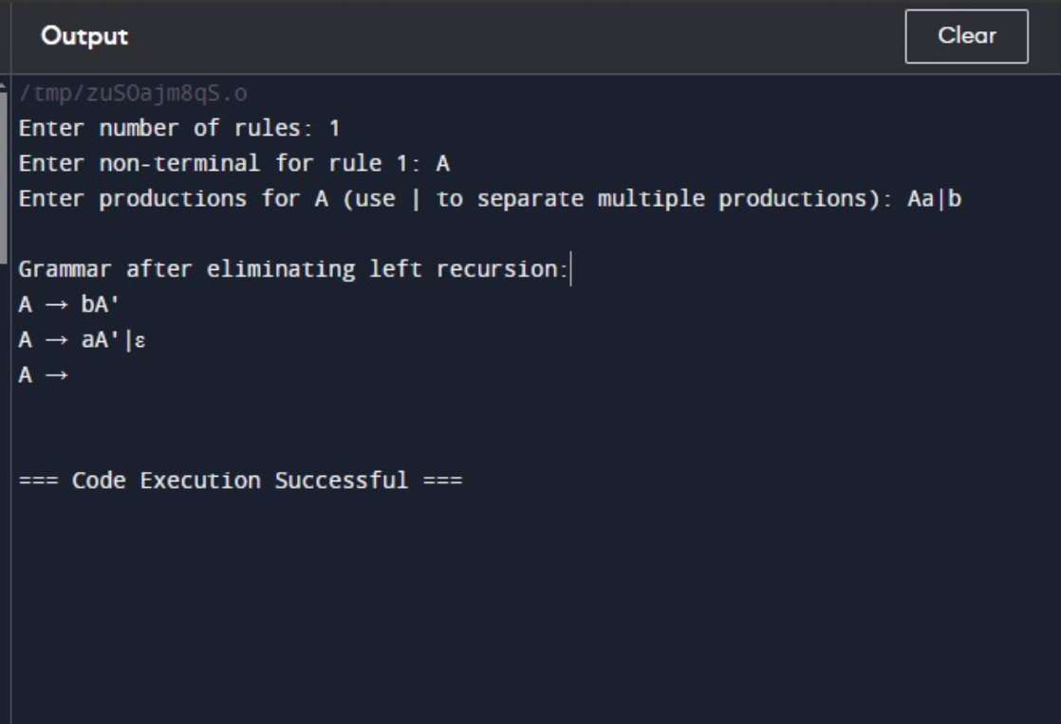
RESULT

Slide 17
07
CONCLUSION

Slide 18
In this project, we explored various memory management strategies in compiler design, including static allocation, stack allocation, heap allocation, and garbage collection.
We discussed the advantages and disadvantages of each approach and presented a comparative analysis of their performance.
Our results show that the choice of memory management strategy significantly impacts the execution time and memory usage of programs.
We also identified opportunities for optimization and improvement in existing memory management techniques
CONCLUSION

Slide 19
THANK YOU!

